Slide 1
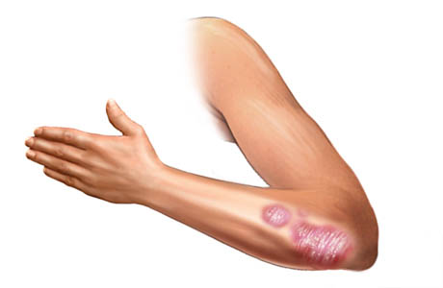
A Computational Biology Framework

Slide 2
Introduction
Feature selection
Lookback
Results
Conclusions
TPOT
Layout improvements
Missing Values
Theory
Feature distributions
Classification results
Framework
Textual design
General comments
Graduation presentation
A Computational Biology Framework

Slide 3
Feature selection
Lookback and TPOT implementation

Slide 4
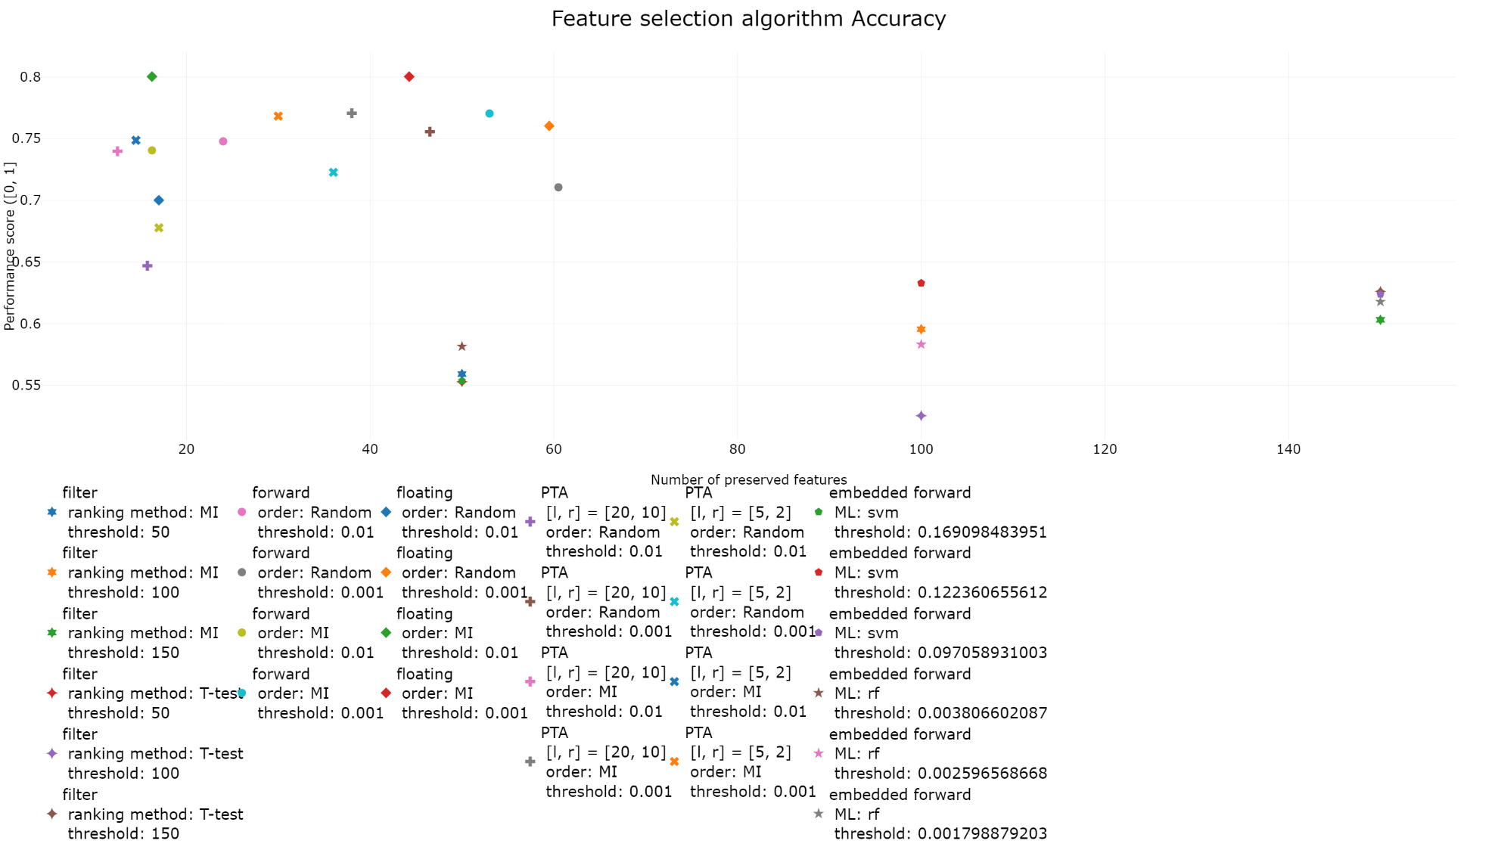
Feature selection
A Computational Biology Framework

Slide 5
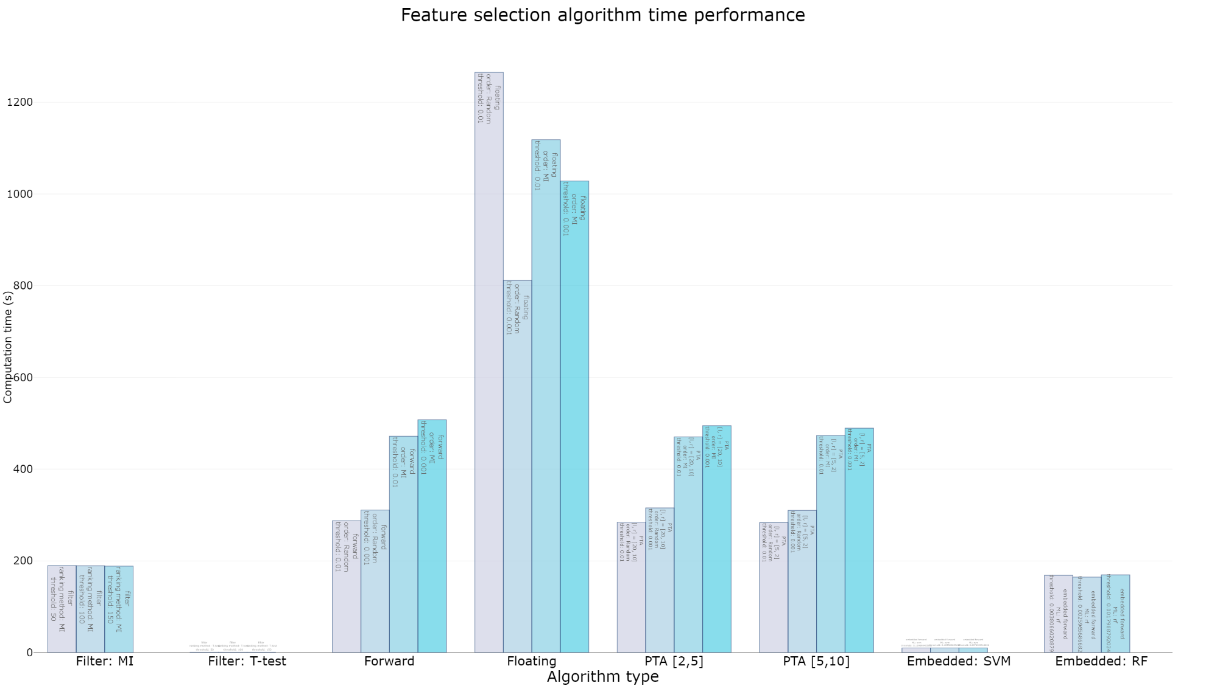
Feature selection
A Computational Biology Framework

Slide 6
Feature
selection
Conclusions
Max of 200 features
Wrapper methods vs. Filter/Embedded methods
Better trade-of features and quality
More computationally intensive
Wrapper methods vs. Filter/Embedded methods
Better trade-of features and quality
More computationally intensive
Sensitive to meta-parameter alpha
A Computational Biology Framework

Slide 7
Feature
selection
TPOT
New accuracy function:
FS_Accuracy = Accuracy(Pipeline) – Features * Threshold
Filter + Embedded methods already present
Two new possibilities:
Always start with feature selection
High feature selection set:
Preservation < 200 features
Wrapper methods included
A Computational Biology Framework

Slide 8
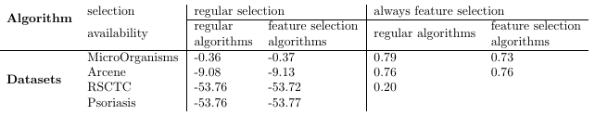
Feature
selection
Test changes TPOT
Use FS_accuracy (threshold of 0.0001)
Made experiments with combinations of:
4 datasets
both types of selection (regular and always feature selection)
both types of algorithm (regular and high feature selection)
Ran everything for:
12 hours
Population of 5
A Computational Biology Framework

Slide 9
Missing values
Theory and experiments

Slide 10
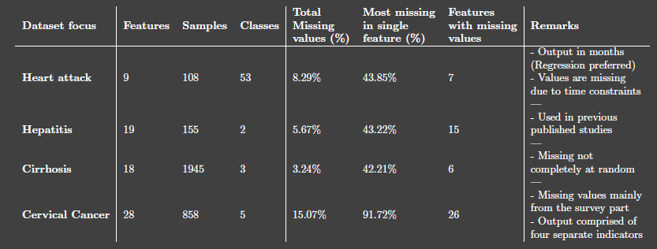
Missing values
Quality Enhancement
Missing values
Outlier detection
Missing values
Missing Completely At Random (MCAR)
Missing At Random (MAR)
Missing Not At Random (MNAR)
Datasets
Four Datasets:
Heart Attacks, Hepatitis, Cirrhosis and Cervical Cancer
Between 1% and 15% of entries being missing values
A Computational Biology Framework

Slide 11
Missing values
List Deletion
Complete Case Analysis
Available Case Analysis
Weighted Case analysis
Single Imputation
Missing indicator imputation
Mean/Median/Mode imputation
Hot deck imputation
Regression imputation
Nearest Neighbor imputation
Multiple Imputation
Multiple Imputation Chained Equations (MICE)
A Computational Biology Framework

Slide 12
Missing
values
Distribution testing
4 datasets
All logical algorithms
List Deletion
ACA not logical
Single Imputation
Missing indicator not logical
Multiple Imputation
MICE : 1 dataset
Feature types (statistical testing, H0: Identical distributions)
Numerical (mean/variance)
Ordinal (median/chi squared)
Categorical (mode/chi squared)
Numerical regression
Distribution changes in p-values
A Computational Biology Framework

Slide 13
Missing
values
Distribution testing results:
Many features not completely missing at random
Imputation sufficient for < 15% missing
List Deletion became better with more missing values
Only looking at features: < 15% missing values
A Computational Biology Framework

Slide 14
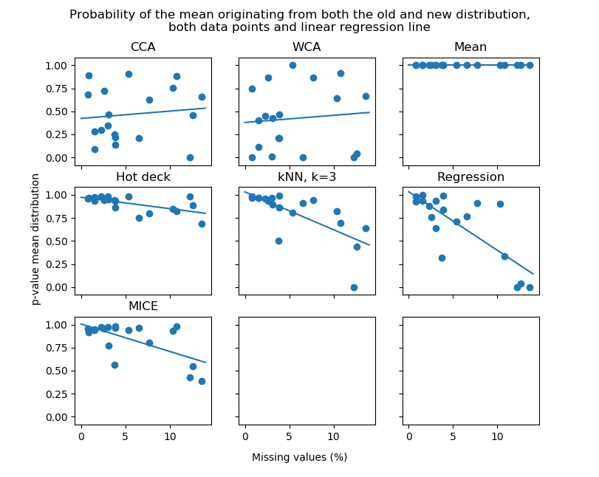
Missing
values
Classification quality
A Computational Biology Framework

Slide 15
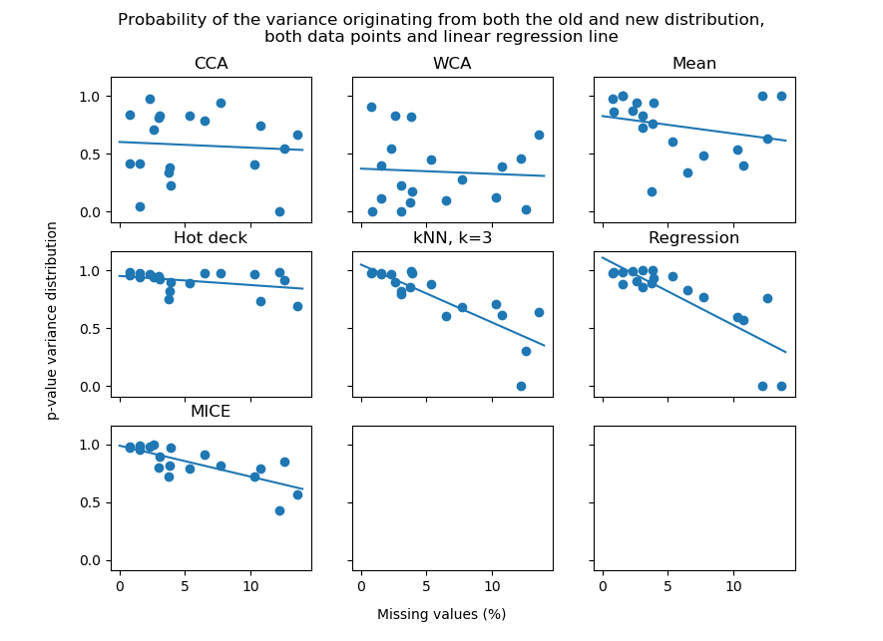
Missing
values
Classification quality
3 classification datasets
All methods
List Deletion
Single Imputation
Missing Indicator (mean and zeros)
kNN (k = 1 and k = 3)
Multiple Imputation
MICE (s = 3 and s = 5, m = 3 and m = 5)
Logistic regression
Two times:
All features
Features with 15% missing removed
A Computational Biology Framework

Slide 16
Missing
values
Classification quality
3 classification datasets
All methods
List Deletion
Single Imputation
Missing Indicator (mean and zeros)
kNN (k = 1 and k = 3)
Multiple Imputation
MICE (s = 3 and s = 5, m = 3 and m = 5)
Logistic regression
Two times:
All features
Features with 15% missing removed
A Computational Biology Framework

Slide 17
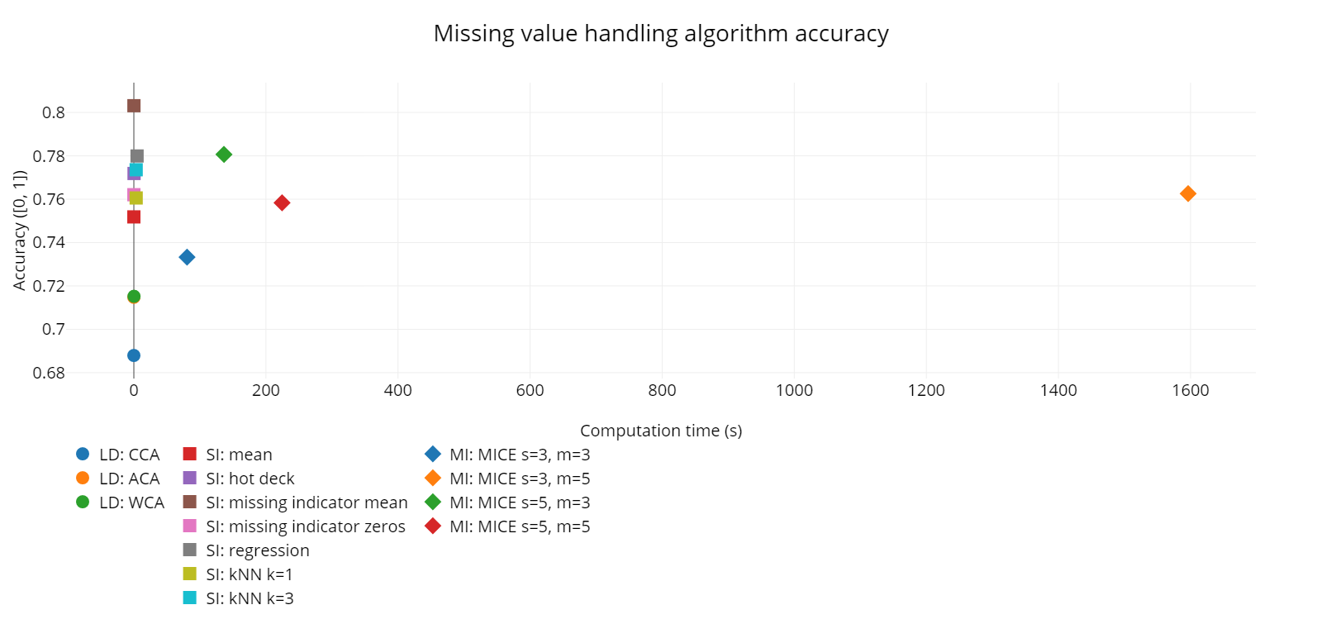
Missing
values
Classification quality
A Computational Biology Framework

Slide 18
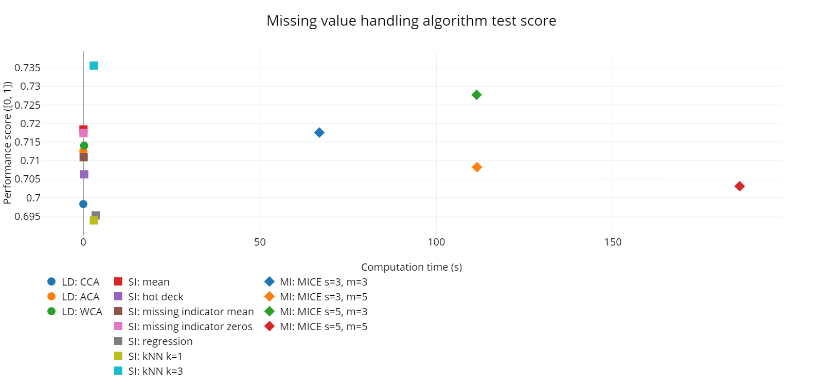
Missing
values
Classification quality (> 15% missing removed)
A Computational Biology Framework

Slide 19
Framework proposal
Manual + GUI

Slide 20
Framework
proposal
Final framework proposal
User Manual
GUI
Implementation current work
Feature selection
Missing value handling
Outlier detection
Global exploration
Meta-learning with TPOT
Helps project starters
Initial understanding dataset
Preprocess explanation and execution
Some initial results
A Computational Biology Framework

Slide 21
General comments
Future + final presentation

Slide 22
General information
Planning
Finish reports + results TPOT and missing values
Quick study outlier handling
Meta-parameter exploration
Create Manual + GUI for Framework
Presentation
Week of 22 October (10 weeks from now)
Approval from biomedical engineering
Letter for Computer Science (this week)
A Computational Biology Framework

